Slide 1

A
Final Project Presentation
on
Design and Realization of a Miniaturized High-Gain LNA for S-Band RF Communication Applications
Minor project
Project Guide
Dr Abhay Chaturvedi
Associate Professor,
Department of ECE,
GLA University, Mathura, India
Presented by
Digambar Singh (2313200005)
Kuldeep (2313200011)
Shyam Baghel (2313200017)
Harish Chaudhary (2315000889)
Department of Electronics & Communication Engineering
Session 2025-26

Slide 2
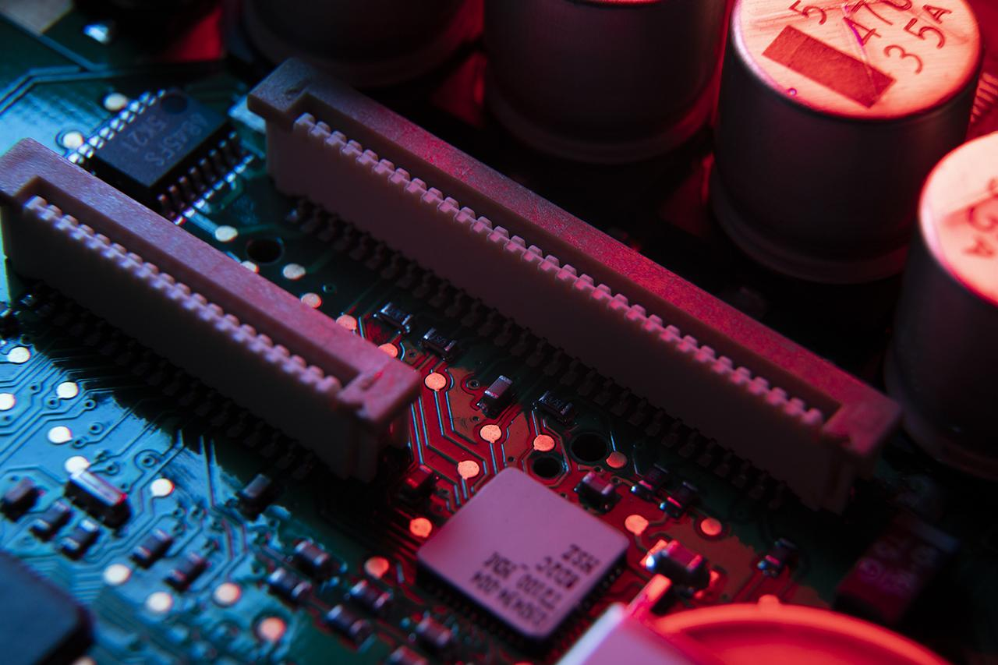
Table of Contents
01
Introduction to LNA
02
Performance Parameters
Background, motivation & objectives
NF, S21, S-parameters, stability
03
LNA Topologies
04
Proposed Design
CS, CG, cascode comparison
Circuit, components, equations
05
Simulation Results
06
Conclusion & Future
Pre & post-layout performance
Summary, limitations, next steps

Slide 3
01
Introduction
to LNA
Fundamentals of Low Noise Amplifiers in RF Systems

Slide 4
Introduction to LNA
A Low Noise Amplifier (LNA) amplifies very weak RF signals while adding minimum noise.
Placed immediately after the antenna — first active element in the RF receiver chain.
Dominates the overall system Noise Figure (Friis formula: F_total = F1 + (F2-1)/G1 + ...)
Operates at radio and microwave frequencies (100 MHz – 100 GHz).
Critical in: satellite communications, GPS receivers, radar, 5G base stations.
This project targets S-Band (2025–2110 MHz) using 0.18 µm CMOS technology.
Cascode common-source topology with inductive source degeneration selected.

Slide 5
RF Receiver Chain – Where LNA Fits
LO
Antenna
BPF
LNA
Mixer
IF BPF
ADC
Figure: Typical RF Receiver Chain — LNA is the first active element after BPF
Friis Noise Formula: F_total = F1 + (F2−1)/G1 + (F3−1)/(G1·G2) + ...
→ High LNA Gain G1 suppresses noise of ALL subsequent stages.
→ Low LNA Noise Figure F1 directly sets receiver sensitivity.

Slide 6

02
Performance
Parameters
Key metrics for evaluating LNA design quality

Slide 7
Performance Parameters of LNA
Noise Figure (NF)
Power Gain (S21)
Degradation in SNR. NF = 10·log(F). Target: ≤ 1.2 dB. Achieved: 1.51–1.74 dB
Forward power gain. G = 10·log(Pout/Pin). Target: ≥ 45 dB. Achieved: 53.23 dB
Input Match (S11)
Output Match (S22)
Input reflection. Target: ≤ −10 dB. Achieved: −42 to −5 dB
Output reflection. Target: ≤ −10 dB. Achieved: −12.75 dB
Rev. Isolation (S12)
Stability (K-factor)
Output→Input leakage. Target: ≤ −30 dB. Achieved: < −48 dB
Unconditional stability: K > 1 and |Δ| < 1 at all frequencies

Slide 8
03
LNA
Topologies
Cascode CS with Inductive Source Degeneration — selected

Slide 9
LNA Topology Comparison
Parameter | CS | CG | Src Degen. | Induct. Degen. | Cascode ✓
Gain | High | Mod | Mod | High | Very High
Noise Figure | Mod-High | Low-Mod | Mod | Very Low | Low
Input Match | Difficult | Easy | Mod | Excellent | Excellent
Stability | Mod | High | High | High | Very High
Linearity | Mod | Good | Good | Very Good | Excellent
✓ Selected: Cascode CS + Inductive Source Degeneration for maximum gain, isolation & low NF

Slide 10
04
Proposed
Design
Circuit design, component values & Cadence schematic

Slide 11
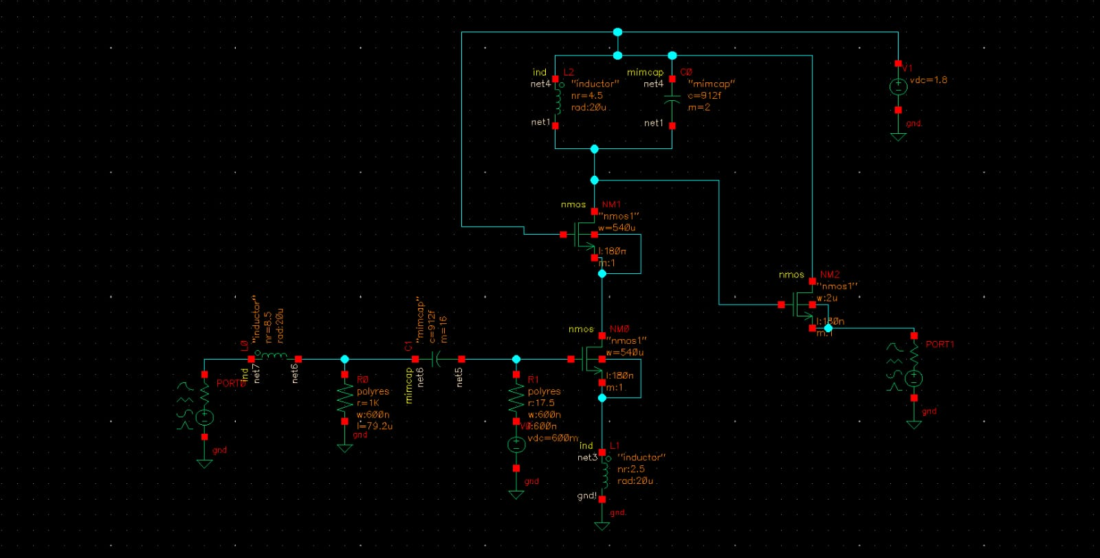
Design Parameters of Proposed LNA
Component | Value
M1, M2 (W/L) | 540 µm / 0.18 µm
M3 Bias (W/L) | 70 µm / 0.18 µm
L1 Gate Inductor | 7.8 nH
L2 Source Inductor | 600 pH
L3 Tank Inductor | 2.5 nH
C1 Input Cap | 1.5 pF
C2 Tank Cap | 2 pF
R1 / R2 | 1 kΩ / 10 kΩ
Vbias / VDD | 0.6 V / 1.8 V
Technology | 0.18 µm CMOS
Frequency | 2025–2110 MHz

Slide 12
Design Equations & Matching Networks
Input Matching Network
Output Tank Network
Re(Zin) = ωT · Ls
ωT = gm / Cgs
Ls = 600 pH → Re(Zin) = 50 Ω
fo = 1/(2π·√[(Lg+Ls)·Cgs])
Lg = 7.8 nH → fo = S-Band
f_tank = 1/(2π·√[L3·C2])
L3 = 2.5 nH, C2 = 2 pF
f_tank ≈ 2.06 GHz ✓
Tank → max Z at resonance
→ max voltage swing
→ max power gain (S21)
Bias: Current mirror — M3 (70µm/0.18µm), Vbias=0.6V, R1=1kΩ, R2=10kΩ divider. M2 gate at VDD=1.8V. Technology: 0.18 µm CMOS. Chip area: 0.637 × 0.402 mm².

Slide 13
Cadence Schematic – Proposed LNA Circuit
Fig 1: Cadence Virtuoso Schematic of Proposed S-Band LNA (0.18 µm CMOS)

Slide 14
05
Simulation
Results
Pre-layout & post-layout performance metrics

Slide 15
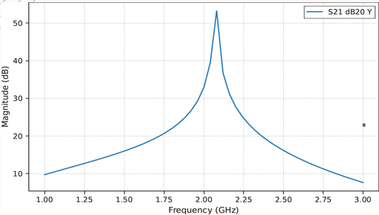
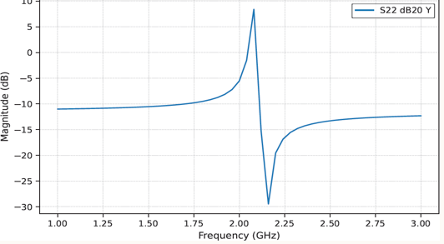
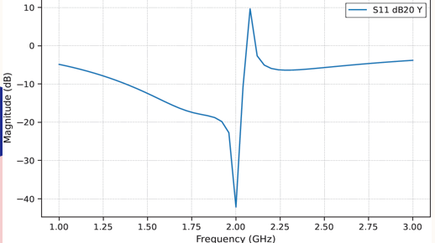
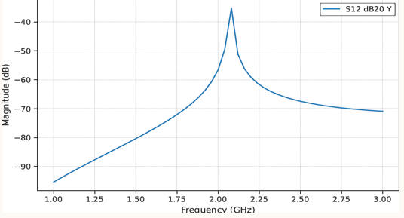
Simulation Results – Key Metrics

Slide 16
Simulation Results – Key Metrics
S21 Peak Gain
Noise Figure
S11 Input Match
53.23 dB
1.51–1.74 dB
−42 to −5 dB
✓ Exceeds 45 dB
≈ Near Target
✓ ≤ −10 dB
S-Band 2025–2110 MHz
S-Band 2025–2110 MHz
S-Band 2025–2110 MHz
S22 Output Match
S12 Isolation
Chip Area
−12.75 dB
< −48 dB
0.637×0.402 mm²
✓ ≤ −10 dB
✓ Exceeds −30 dB
✓ Compact
S-Band 2025–2110 MHz
S-Band 2025–2110 MHz
S-Band 2025–2110 MHz

Slide 17
Performance Summary Table
Parameter | Target | Pre-Layout | Post-Layout
Frequency Band | 2025–2110 MHz | 2025–2110 MHz | 2025–2110 MHz
Peak S21 Gain | ≥ 45 dB | 53.23 dB ✓ | ~50 dB
Noise Figure (NF) | ≤ 1.2 dB | 1.51–1.74 dB | ~1.6–1.9 dB
S11 Input Match | ≤ −10 dB | −42 to −5 dB ✓ | ≤ −10 dB ✓
S22 Output Match | ≤ −10 dB | −12.75 dB ✓ | ≤ −10 dB ✓
S12 Isolation | ≤ −30 dB | < −48 dB ✓ | < −45 dB ✓
Chip Area | Miniaturized | 0.637×0.402 mm² | 0.637×0.402 mm²
Technology | 0.18 µm CMOS | 0.18 µm CMOS | 0.18 µm CMOS

Slide 18
Advantages & Limitations
ADVANTAGES
LIMITATIONS
Very high gain (53.23 dB) – suppresses downstream noise
Excellent reverse isolation (< −48 dB)
Noiseless 50 Ω input matching (inductive degeneration)
Compact 0.637×0.402 mm² — satellite payload ready
Standard CMOS — co-integrable with digital circuits
Robust across all process corners (TT/FF/SS/FS/SF)
NF 1.51–1.74 dB slightly above ≤1.2 dB target
Narrowband — LC tank limits to S-band only
On-chip inductors dominate area, limit Q-factor
IIP3/P1dB linearity not yet fully characterized
Silicon fabrication and testing still pending
Post-layout parasitic effects reduce gain/NF slightly

Slide 19
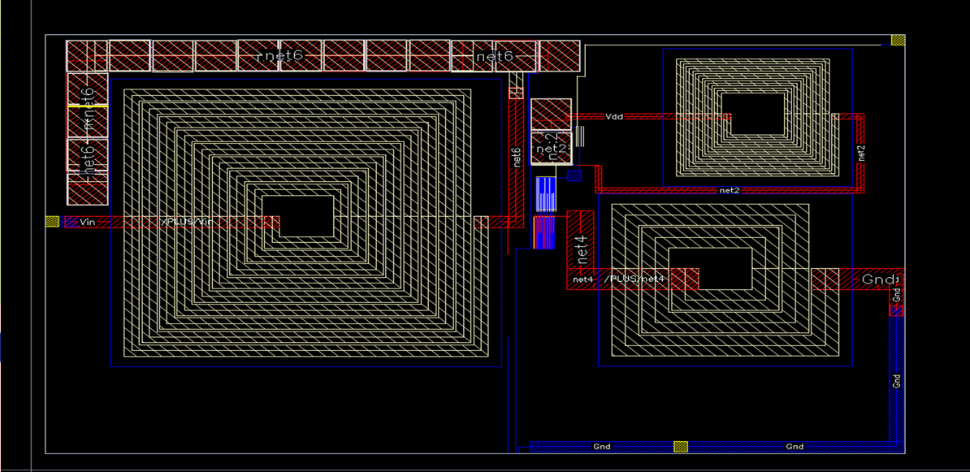
Post Layout Simulation

Slide 20
06
Conclusion &
Future Scope
Summary and next steps

Slide 21
Conclusion
Designed a cascode CS LNA with inductive source degeneration in 0.18 µm CMOS for S-Band (2025–2110 MHz).
Peak S21 = 53.23 dB — exceeds 45 dB target. Excellent reverse isolation S12 < −48 dB.
Noise Figure 1.51–1.74 dB across S-Band (minimum 1.25 dB at 1.6–1.7 GHz).
Input match S11 ≤ −10 dB at band centre. Output match S22 = −12.75 dB.
Compact chip area 0.637 × 0.402 mm² — suitable for satellite payload integration.
Layout completed. Post-layout simulation confirms design integrity under parasitics.
All process corners (TT/FF/SS/FS/SF) pass, confirming manufacturing robustness.

Slide 22
Future Scope
Fabrication (MPW)
Linearity Testing
NF Optimization
01
03
02
Submit for Multi-Project Wafer run; on-wafer RF testing with VNA.
Full IIP3 and P1dB characterization in simulation & silicon.
Improve spiral inductor Q; target NF ≤ 1.2 dB.
Receiver Front-End
Wideband LNA
0.13 µm Migration
05
04
06
Integrate LNA + Mixer + VCO into complete RF receiver.
Full S-Band (2–4 GHz) using noise-cancelling topology.
Port to finer process for higher fT, lower NF, smaller area.

Slide 23
Thank You!
Design & Realization of Miniaturized LNA for S-Band RF Communication | ECE Final Year Project
Technology: 0.18 µm CMOS | Frequency: 2025–2110 MHz | Topology: Cascode CS + Inductive Source Degeneration

